Slide 1
Flying flamingos
WANG Qianwen
LIU Suyun

Slide 2
Content
Available parts
Overall structures
Terrain design
Light setting
Mesh manipulation
User Interaction

Slide 3
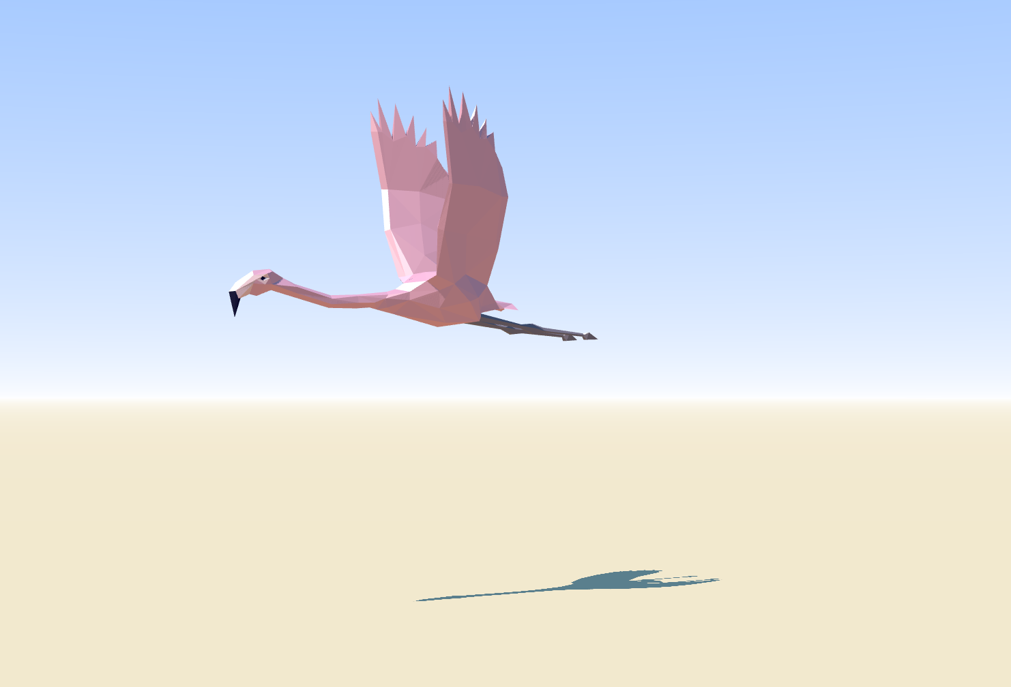
Available parts
Flamingo geometry (flamingo.js)
Vertices and faces
morph targets for animation: 14 status during its flying
(https://threejs.org/examples/#webgl_lights_hemisphere)

Slide 4
Overall structures
6 flamingos with animation effects
Camera moves with flamingos
Fireball heading to flamingos
Eviroment: sky, ocean, island
Ambient light and direct light

Slide 5
Overall structures
3 pairs of fragment and vertex shaders
Initialized scene: camera, light, background texture, mesh loader and render setting
Animated scene: Light position, light intensity, mesh position and texture, camera position

Slide 6
Terrain design
Ball space
Create double-side texture by vertexShader and fragmentShader
(some modification on its texture)
Ground sea and island
(sea amination is needed especially when camera stops)
Height map simulate terrains
vertexShader3 and fragmentShader3

Slide 7
Light setting
Ambient Light
White color with lower density (night) and higher density (day)
Direct Light in the night
Density increases gradually to certain value
Position change over the flamingo’s position, mimic the effect of sun rising
Direct light in the day
Simulate the Sun with constant high density
Keep stationary on the sky

Slide 8
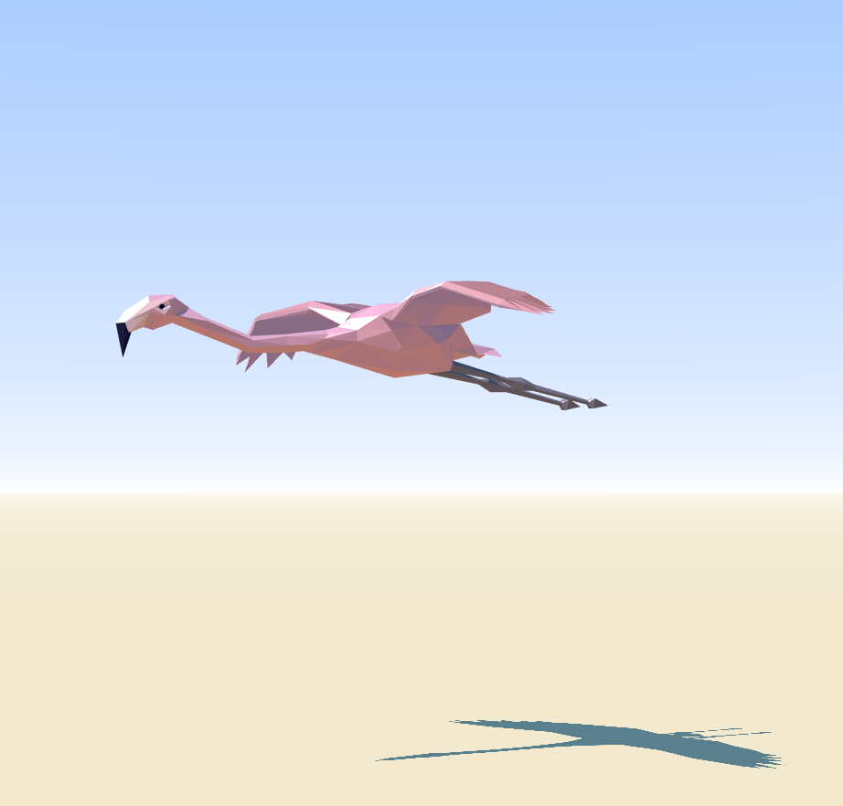
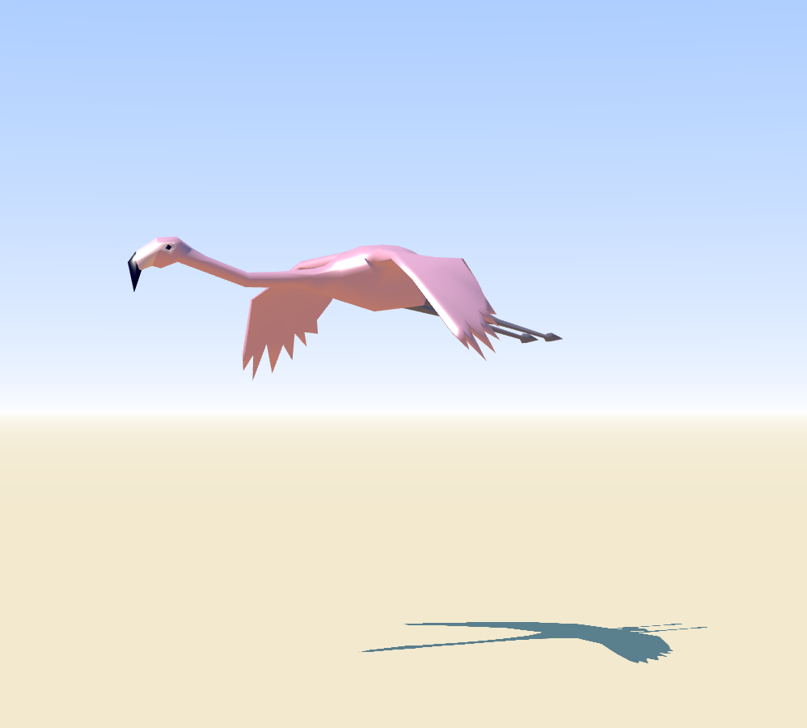
Mesh manipulation:flamingo
Morph normals:
var material =
new THREE.MeshPhongMaterial( {
color: 0xffffff,
specular: 0xffffff,
shininess: 20,
morphTargets: true,
vertexColors: THREE.FaceColors,
shading: THREE.FlatShading } );
geometry.computeMorphNormals();
geometry.computeVertexNormals();
var material =
new THREE.MeshPhongMaterial( {
color: 0xffffff,
specular: 0x050505,
shininess:100,
morphTargets: true,
morphNormals: true,
vertexColors: THREE.FaceColors,
shading: THREE.SmoothShading} );

Slide 9
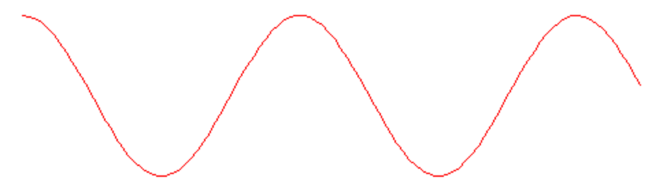
Mesh manipulation:flamingo
Position
Before hitting the ball:
meshes[ i ].position.x-=step;
meshes[i].position.y=50 + 4*Math.cos(px/10);
When hitting the ball:
meshes[ i ].position.x-=step;
if(Math.abs(px-meshes[meshlen].position.x)<60){
meshes[i].position.y=50+25*Math.cos(0.5*Math.PI*(px-meshes[meshlen].position.x)/60)}

Slide 10
Mesh manipulation: flamingo
Animation: morph targets
var mixer = new THREE.AnimationMixer( mesh ); mixer.clipAction( geometry.animations[ 0 ] ).setDuration( 1 ).play();
mixers.push( mixer );
var vertices = [];
for ( var v = 0; v < geometry2.vertices.length; v ++ ) {vertices.push( geometry2.vertices[ v ].clone() );
vertices[ vertices.length - 1 ].x *= 2;
vertices[ vertices.length - 1 ].x *= 10*Math.abs(i-2.5);
vertices[ vertices.length - 1 ].z *= 2;
geometry2.morphTargets.push( { name: "target" + i, vertices: vertices } );
var mixer = new THREE.AnimationMixer( mesh );
var clip =THREE.AnimationClip.CreateFromMorphTargetSequence( 'gallop', geometry2.morphTargets, 3 ); mixer.clipAction( clip ).setDuration( 0.8+0.2*Math.random() ).play();

Slide 11
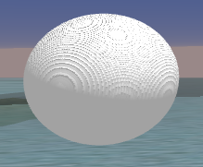
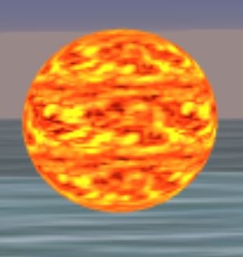
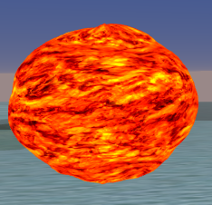
Mesh manipulation: hitting ball
Hitting ball
Ball geometry
vertexShader2 and fragmentShader2
texture
(in fragment shader, change fragment color)
Bump
(in vertex shader, chage position)
The same method for island mesh

Slide 12
User Interaction
Keyboard
0: stop or continue any movement;
1: move along positive x (right);
2: move along negative x (left, by default);
3: move along positive y (down);
4: move along negative y (up);
5: move along positive z (farther);
6: move along negative z (nearer);

